Slide 1

Metabolic Control Analysis
Herbert M Sauro
Bioengineering, University of Washington

Slide 2
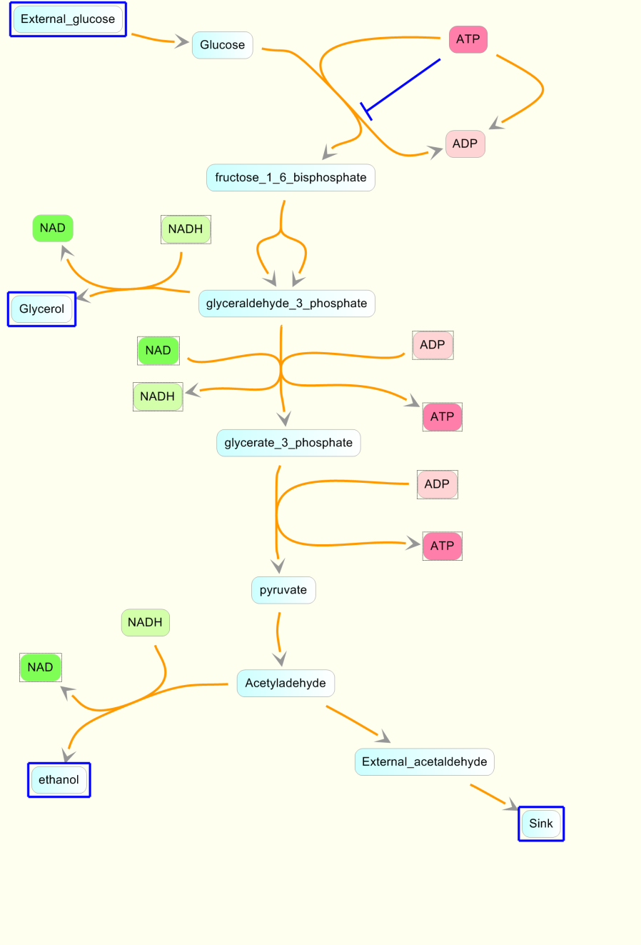
One way to understand networks: Simulation
One possible way to understand
how perturbations propagate
through a pathway is to carry out
simulations.

Slide 3
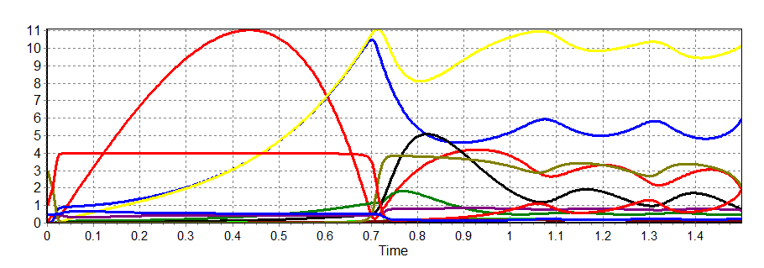
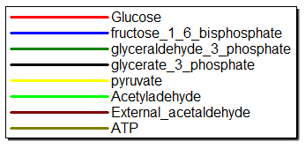
One Possible Solution: Simulation
One possible way to understand how perturbations propagate
through a pathway is to carry out simulation, such as:

Slide 4
Introduction to MCA
Basic Science Questions
1. Quantify how different components of a pathway influence concentrations and fluxes.
2. Quantify the degree to which perturbations move through a system.
3. Understand how feedback control affects pathway behavior.
Applied Questions
Which enzymes to re-engineer to increase production in a metabolic pathway?
Identify new drug targets.

Slide 5
Introduction to MCA
It's origins:
Three groups, Edinburgh, Berlin, and Michigan, simultaneously
and independently developed almost an identical theory to the
analysis of perturbations in biochemical pathways.
What is it?
The approach (called MCA here, also BST and MCT), aims to achieve a quantitative understanding of the relationship between genotype and phenotype, to understand systems behavior in terms of the unit processes (enzymes) that make up biochemical pathways.

Slide 6
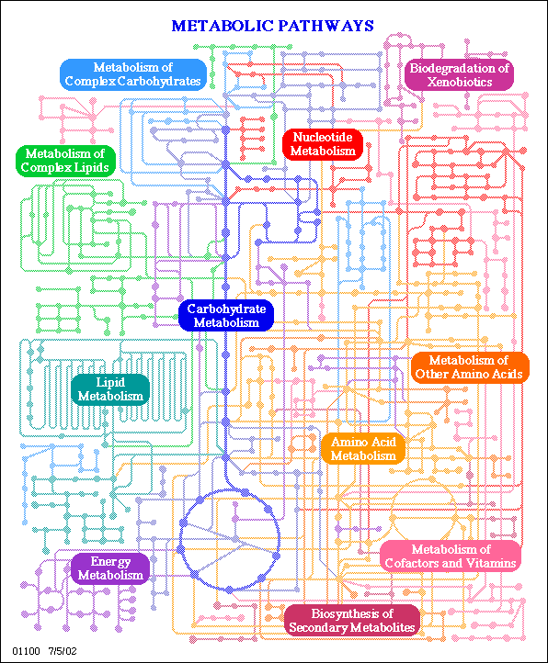
Perturbations
Change the activity of one
enzyme, e.g. PFK - gene
expression change or
addition of an inhibitor (drug)
What effect does this have on the
concentration of fluxes and/or
metabolite concentrations?
E.g. Pyruvate or Krebs Cycle Flux?

Slide 7
Principle I
The behavior of a part or set of parts only makes sense when related to its functional context.

Slide 8
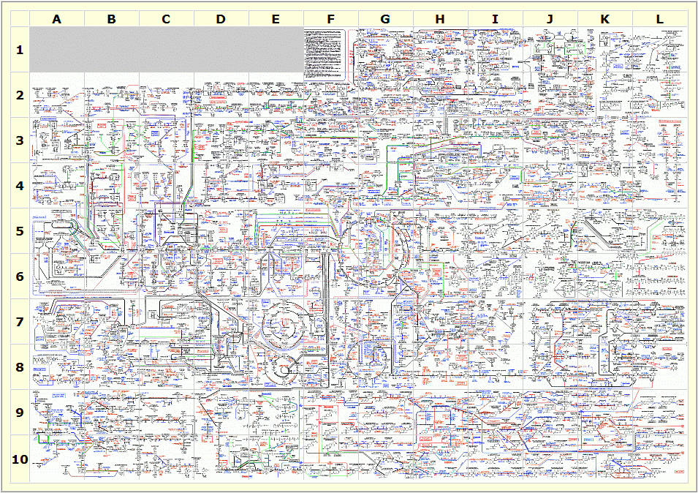
Principle 2(a)
A living cell is a molecular democracy with a distributed decision making apparatus.

Slide 9
Principle 2(b)
A living cell does not operate like a digital computer, with a program and sequential operation.

Slide 10






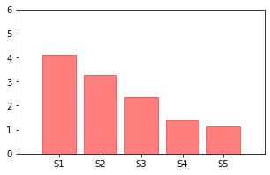
Dynamics is Critical to Understand Cell Biology
Perturbation to this Enzyme

Slide 11

Perturbation to E3
Increase this Enzyme at time = 75
Irreversible steps
Reversible steps

Slide 12
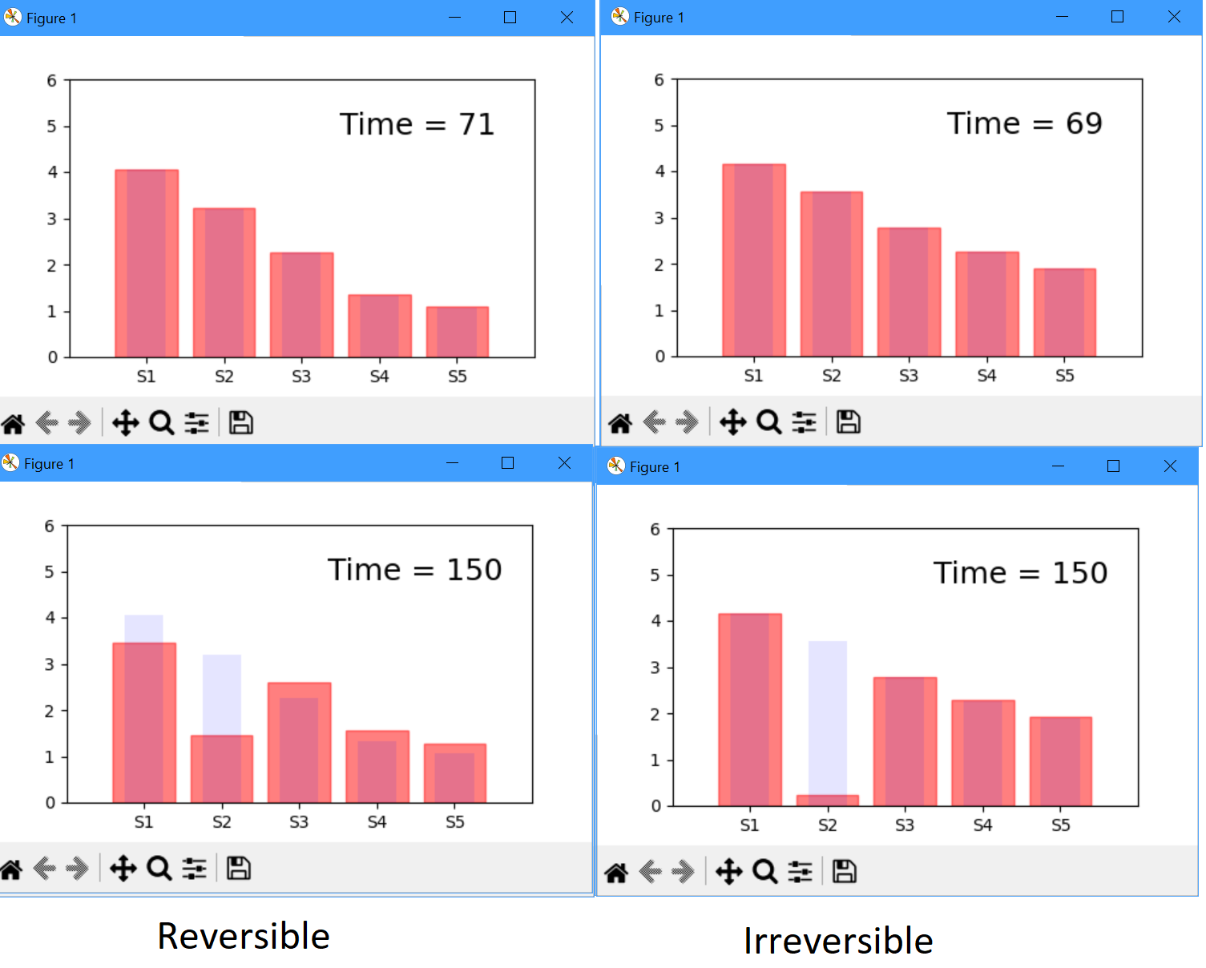
Perturbation to E3 after 75 secs

Slide 13






Conclusion: Irreversible Case
Increase this Enzyme
No change
No change
No change
No change
Pathway flux unchanged!
There is no communication along the pathway

Slide 14
Conclusion: Reversible Case
Increase this Enzyme
No change
No change
No change
Pathway flux increased
There is no communication along the pathway

Slide 15

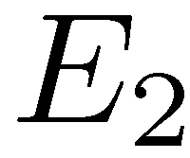
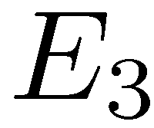
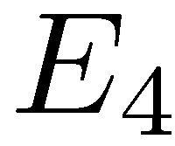
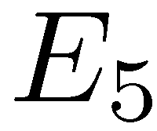







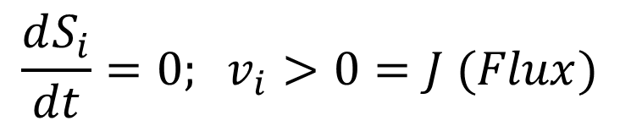
A Theory of how Perturbations Propagate
Consider the following simple pathway:
Assume that the pathway is in steady state:

Slide 16
Exercise
Generate random network
Compute steady state
Plot concentrations
Perturb enzyme, recompute steady state

Slide 17
Hints:
Generate random network
import teUtils as tu
p1 = tu.buildNetworks.getLinearChain(10, 'Michaelis')
Look at the model
print (p1)
Load the model
r = te.loada (p1)
Compute steady state and collect solution
r.steadyState()
sp1 = r.getFloatingSpeciesConcentrations()

Slide 18
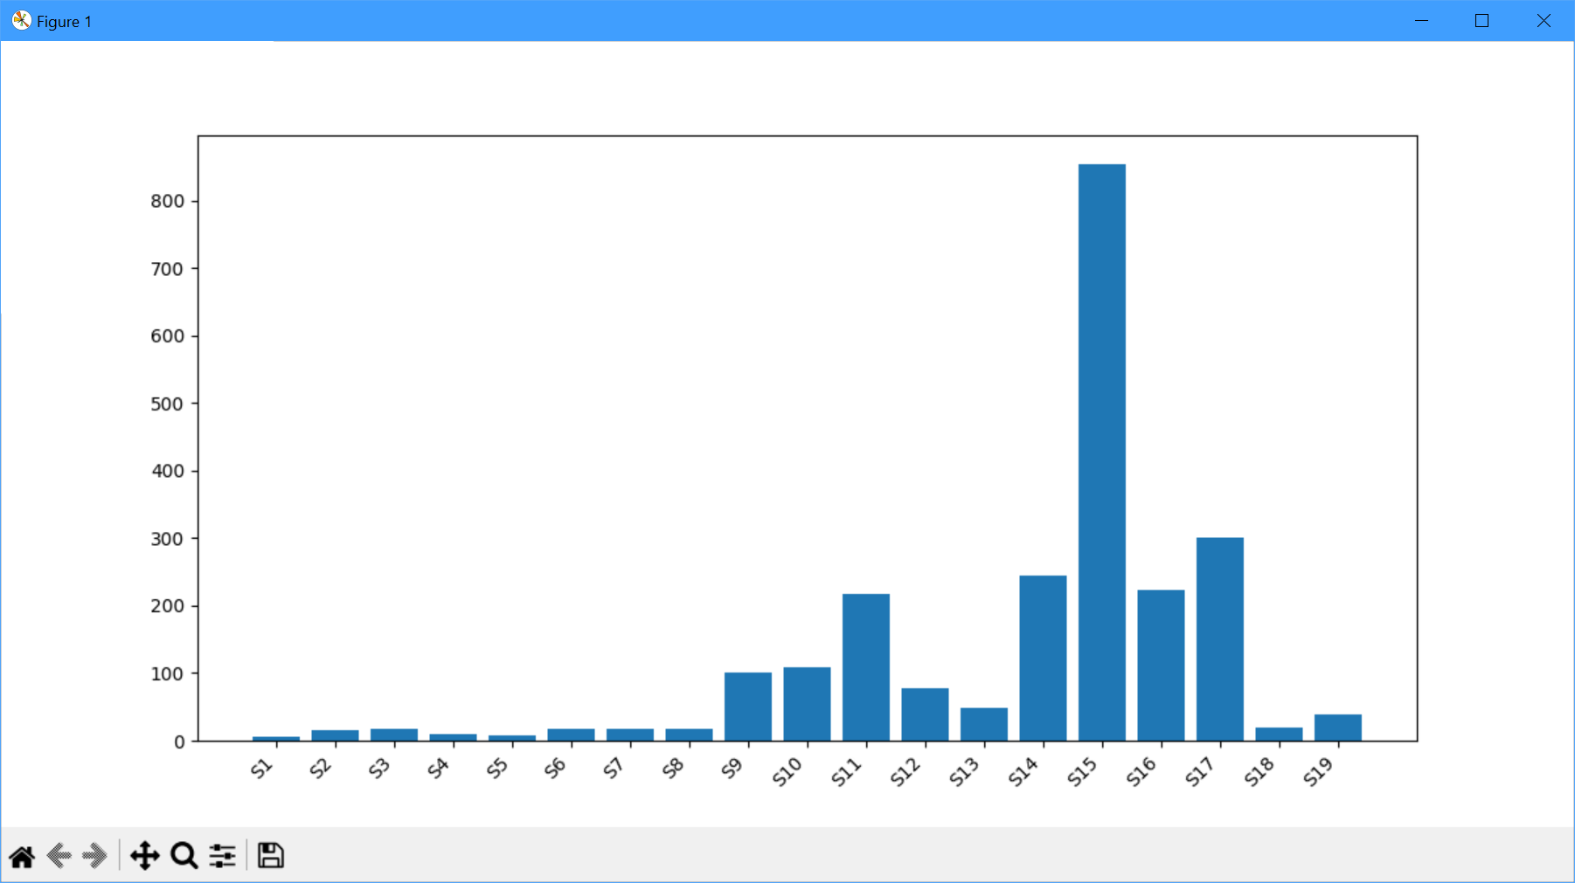
Hints:
5. Plot the concentrations
tu.plotting.plotFloatingSpecies(r)

Slide 19
Hints:
5. Perturb enzyme, recompute steady state
r.Vm5 = r.Vm5*2
6. Recompute steadystate
r.steadyState()
sp2 = r.getFloatingSpeciesConcentrations()
7. Plot both sets of data
# Width of a bar
width = 0.4
plt.bar(np.arange(9), sp1, width, label='Vm5 = ' + str (r.Vm5/2))
plt.bar(np.arange(9)+width, sp2, width, label='Vm5 = ' + str (r.Vm5))
plt.legend()
plt.show()

Slide 20
Steady State Response
Increase E5:
v5 Increases
S4 Decreases
v4 Increases
S3 Decreases
v3 Increases
etc.

Slide 21
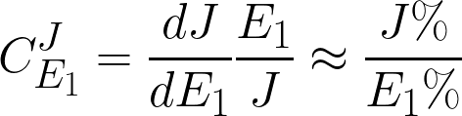
A Theory of how Perturbations Propagate
We can make a small perturbation in the activity of the
first enzyme, E1. This will cause the system to change to a new
steady state with a new set of species concentrations and a new
flux.
This thought experiment can be represented mathematically by the flux control coefficient:

Slide 22
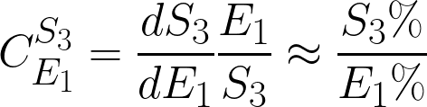
A Theory of how Perturbations Propagate
We can make a small perturbation in the activity of the
first enzyme, E1. This will cause the system to change to a new
steady state with a new set of species concentrations and a new
flux.
This thought experiment can be represented mathematically by the concentration control coefficient:

Slide 23





Deductive Reasoning: Operational Experiments

Slide 24
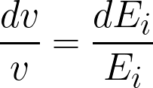
Deductive Reasoning: Operational Experiments

Slide 25


Deductive Reasoning: Operational Experiments

Slide 26
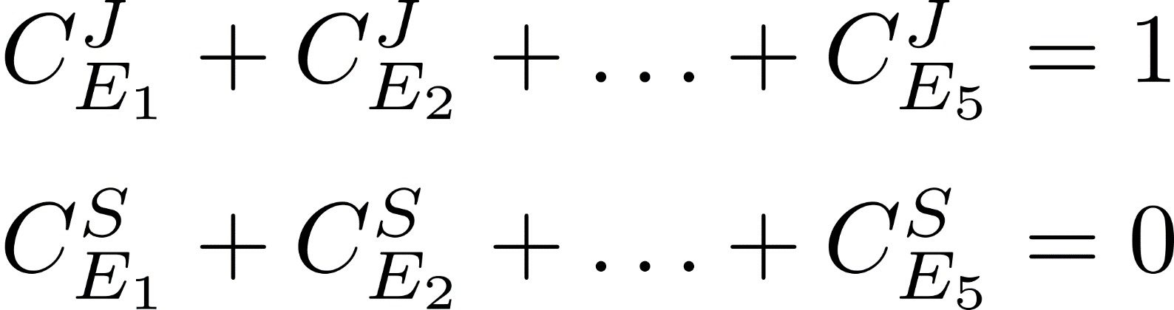
Summation Theorems

Slide 27
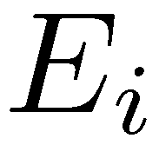
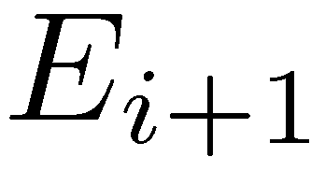

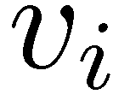
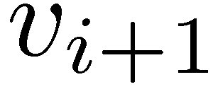
Intuition
Increase both enzyme levels by the same fraction. If reaction
Rate is proportional to E then both rates go up by the same
proportion. Since the flows in and out are undisturbed, S remains
unchanged.

Slide 28
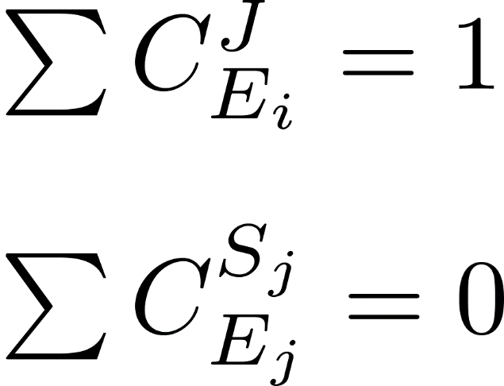
Summation Theorem
Control is shared among all steps in a pathway.
If one step gains control, one or
more other steps, must lose control.

Slide 29
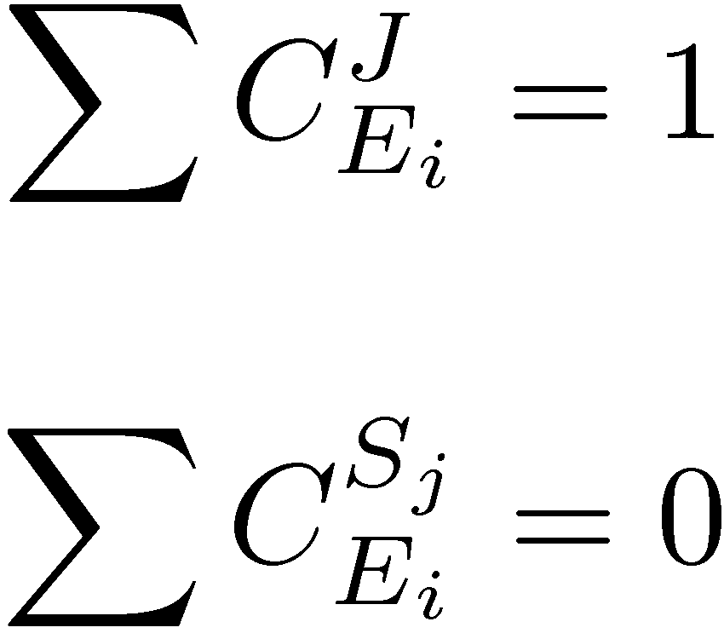
Summation Theorems
Implication:
With n steps, the average flux
control must be 1/n, i.e. a small
number. This result suggests that
reaction pathways are naturally
robust.

Slide 30
Let’s see if that is true: Exercise
Generate a random pathway
p1 = tu.buildNetworks.getLinearChain(10)
r = te.loada(p1)
Compute steady state
r.steadyState()
Compute flux control coefficients
tu.plotting.plotFluxControlHeatMap(r)
What distribution do you see?

Slide 31
What about some real values?
The following information was taken from a paper by S. Thomas et al, Biochemical Journal, 1997, 322, 119-127
Enzyme | Flux Control Coefficient
PGM | 0.029
PGI | 0.139
PFK | 0.132
Aldolase | 0.0
TPI | 0.0
GAPDH/PGK | 0.001
enolase | 0.005
PK | 0.702
Sum | 1.008
Glycolysis in tuber tissue of potato.
Values computed
using a combination
of calculation and
experimental measurement.

Slide 32
Principle 3
Principle 4
There is no such thing as a rate-limiting step, only degrees of limitingness which can be quantified.
Whether an enzyme limits flux or not is a systemic property and cannot be determined by looking at the enzyme alone.

Slide 33

Properties of the Unit Processes

Slide 34
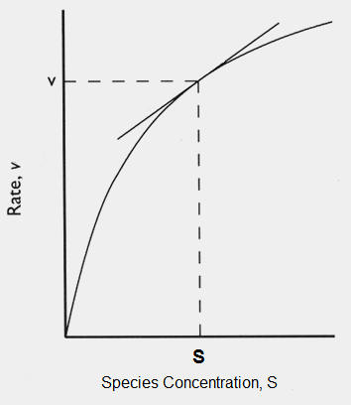
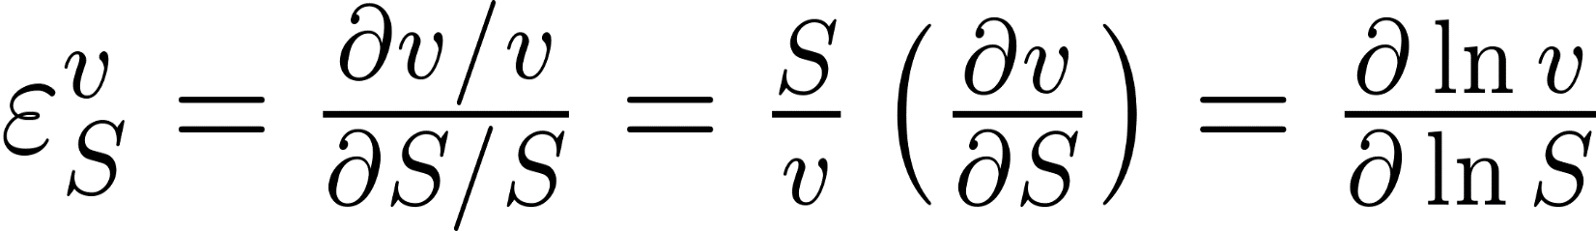
Properties of the Unit Processes
Elasticity Coefficient

Slide 35
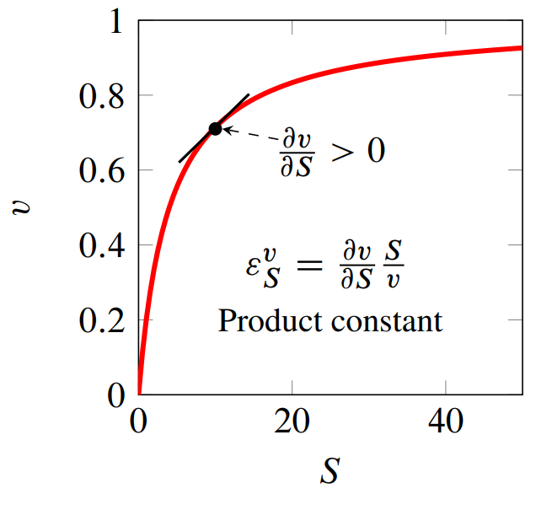
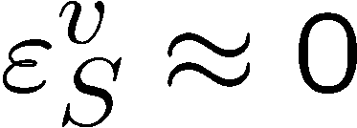
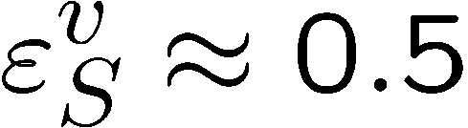
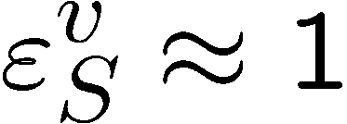
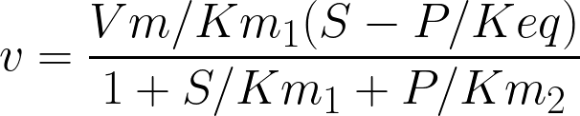
Elasticity Coefficients: Substrate
Assume Product = 0

Slide 36
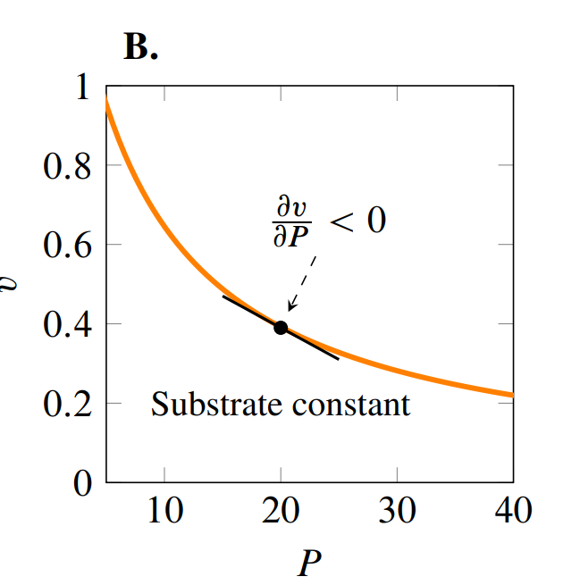



Elasticity Coefficients: Product
Assume Substrate = 0

Slide 37
Elasticity Coefficients
Substrate elasticities tend to be positive
Product elasticities tend to be negative

Slide 38
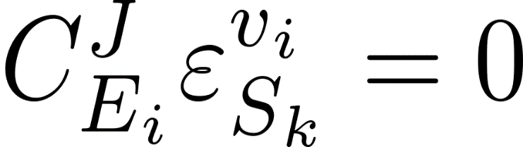

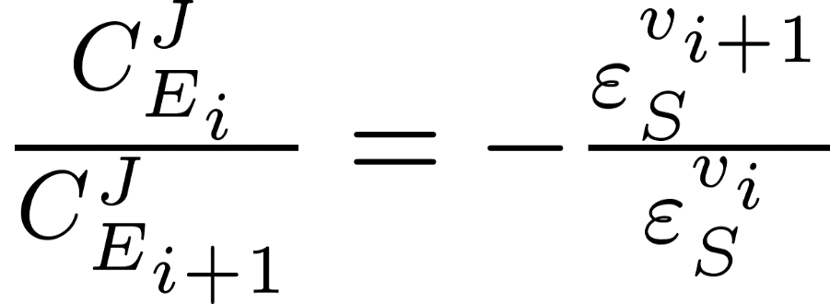
Connection between the Control Coefficients and the Elasticities
Determines how local kinetic effects influence pathway control
Rearranged:

Slide 39
Connectivity Theorem
Determines how local kinetic effects influence pathway control
High control on step i means a high elasticity on step i+1
A flux control coefficient is inversely proportional to the
adjacent elasticity

Slide 40
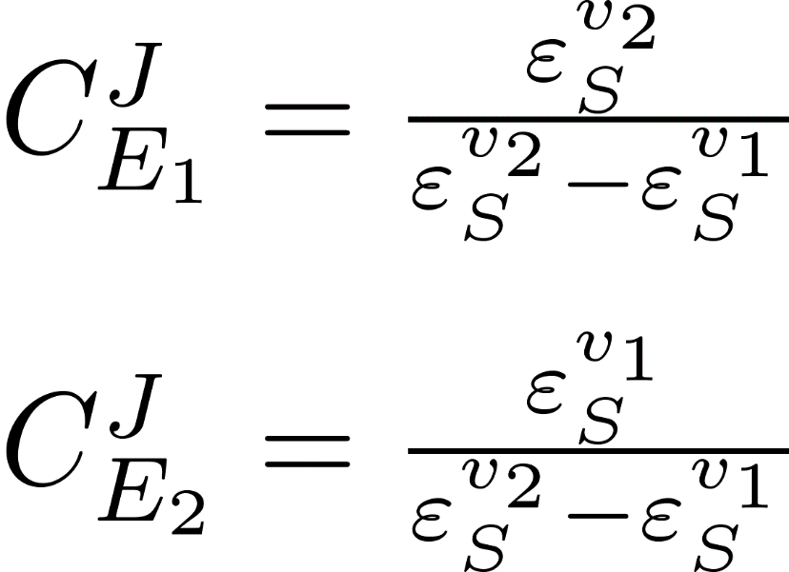
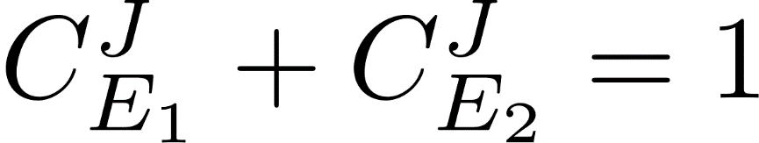
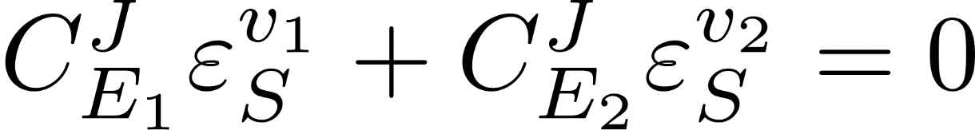
Combining the Connectivity and Summation Theorems
Determines how local kinetic effects influence pathway control
This allows us to relate systems properties to local kinetic properties.

Slide 41
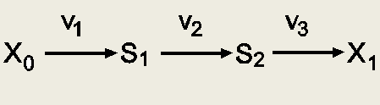
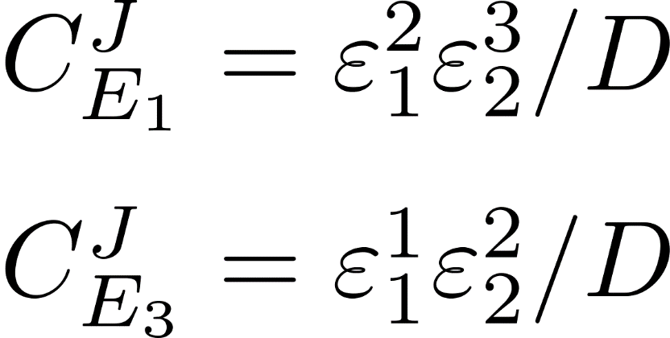
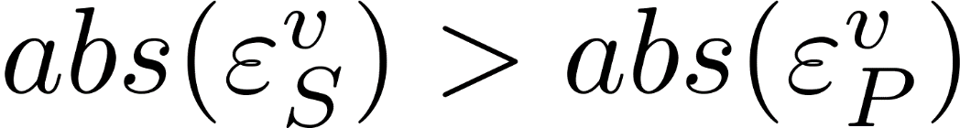
Simple Linear Chain: Signal Paths
Has all the substrate elasticities
Has all the product elasticities

Slide 42
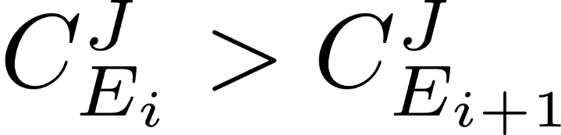
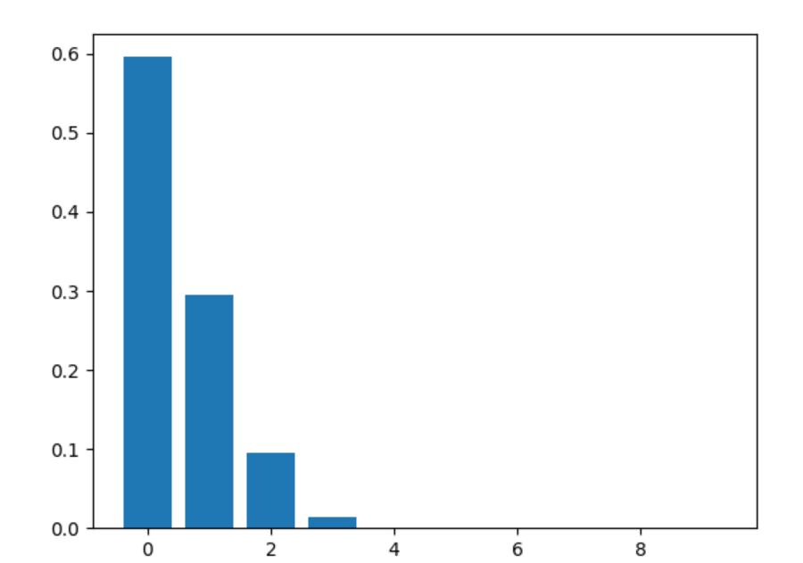
Front-Loading
m = r.getScaledFluxControlCoefficientMatrix()
plt.bar (range (10), m[0])

Slide 43
Principle 5
In an unregulated pathway with only mass-action or Michaelis-Menten kinetics, sensitivity of the flux to enzyme changes is biased toward the front of the pathway.

Slide 44
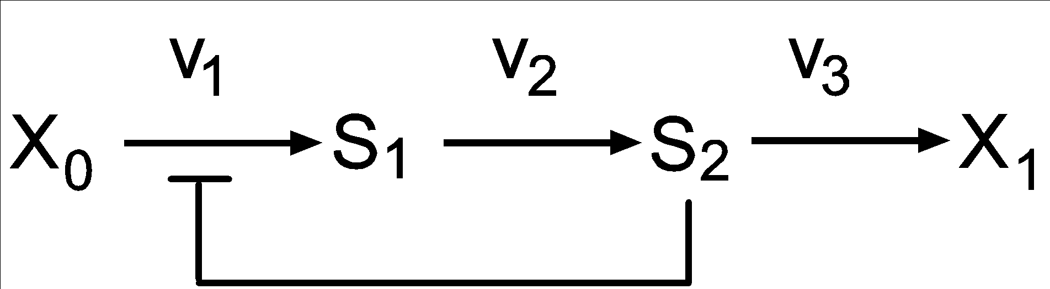
Negative Feedback
What happens when we include a
negative feedback loop?

Slide 45
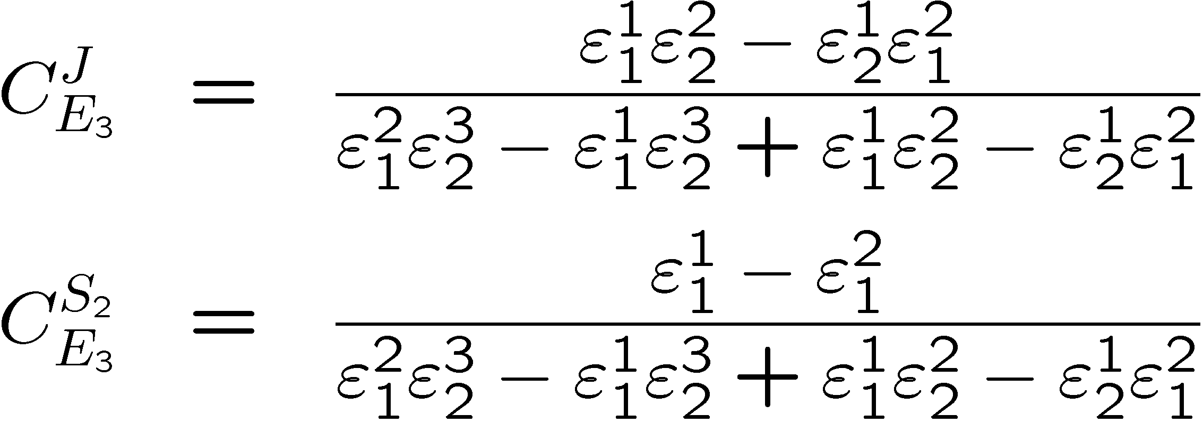
Negative Feedback
Feedback
Elasticity

Slide 46
Negative Feedback
Feedback
Elasticity

Slide 47
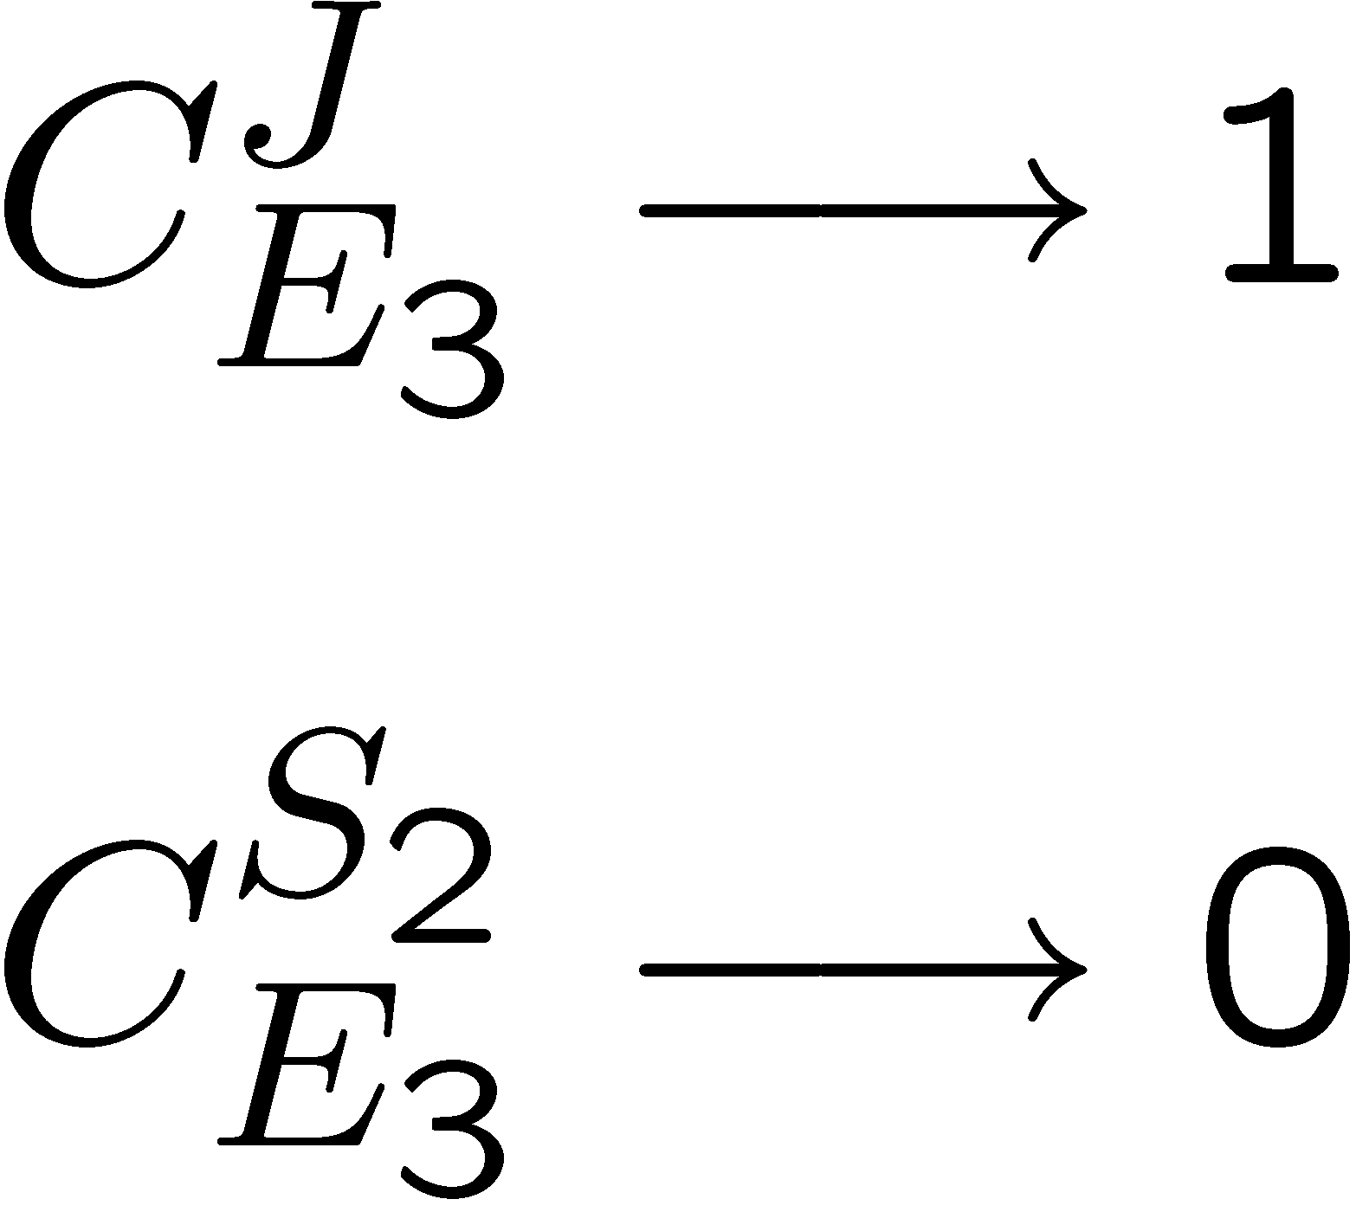
Negative Feedback

Slide 48
Negative Feedback
Feedback has the following consequences:
All flux control moves downstream beyond the signal leaving little or no flux control upstream. In fact, the ‘controlled’ step has very little flux control.
The signal molecule shows strong homoeostasis

Slide 49
Negative Feedback
The net effect of this is that feedback control creates a demand
controlled network. That is, control over the flux through the
pathway is determined largely by the demand for S2.
Important examples is this include:
Glycolysis
Amino acid biosynthesis

Slide 50

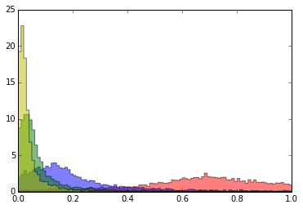
Effect of Negative Feedback
5000 simulations of a 4 step linear pathway. Randomizing
rate constants while keeping Keqs fixed.
Step 4
Frequency
Step 3
Step 1
Step 2
Front loading
Flux Control Coefficient

Slide 51
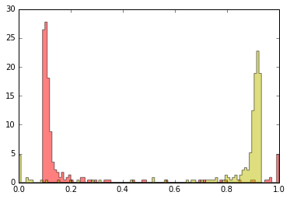
Effect of Negative Feedback
5000 simulations of a 4 step linear pathway. Randomizing
rate constants while keeping Keqs fixed.
Step 1
Step 4
Frequency
Flux Control Coefficient

Slide 52
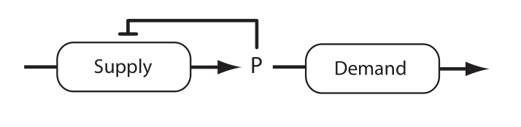
Supply and Demand

Slide 53
Serine metabolism: Ambidextrous Pathway
Bacteria
3-phosphoglycerate
phosphohydroxypyruvate
phosphoserine
serine
Humans
3-phosphoglycerate
phosphohydroxypyruvate
phosphoserine
serine
Biochem. J. (1988) 256, 97-101 (Printed in Great Britain) Control analysis of mammalian serine biosynthesis, Fell and Snell.

Slide 54

Serine metabolism: Ambidextrous Pathway
Low Flux (24hr fasted) – demand control
3-phosphoglycerate
phosphohydroxypyruvate
phosphoserine
serine
0.03
0.97
High Flux (Glucose+Ethanol) – supply control
3-phosphoglycerate
phosphohydroxypyruvate
phosphoserine
serine
0.46
0.54
Biochem. J. (1988) 256, 97-101 (Printed in Great Britain) Control analysis of mammalian serine biosynthesis, Fell and Snell.

Slide 55
Principle 7
Steps regulated by feedback control are insensitive to changes in their enzyme activity.
Classical rate limiting steps such as Phosphofructokinase in glycolysis are not rate limiting.

Slide 56
Principle 8
Metabolic feedback and the rarer feed-forward loops ensure homeostasis of metabolites through the control of supply and demand.

Slide 57
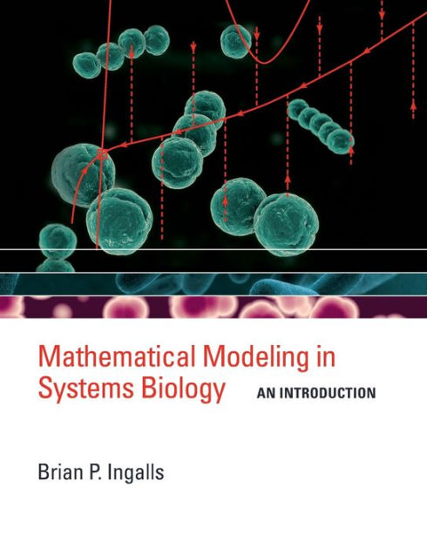
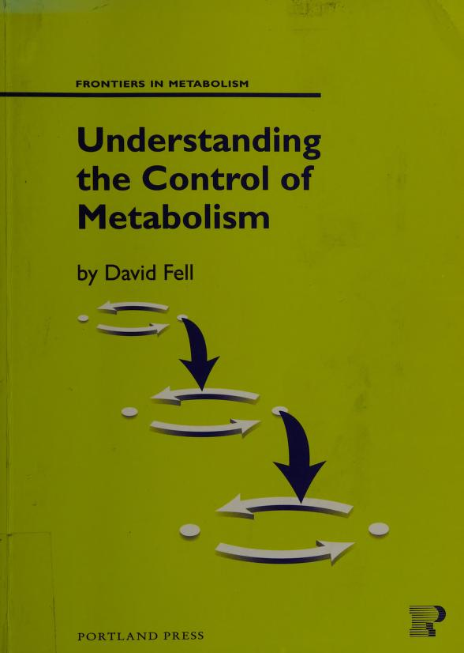
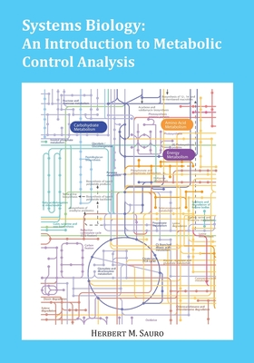
Further Information
Wikipedia
3. Ingalls: Amazon, and his web site (pdf)
2. Fell, at archive.org
3. Sauro, Amazon, and gumroad (pdf)

Slide 58


Linear Chain: Front Loading
Consider a simple linear chain:
That is, steps near the start of a pathway have more
control over the flux than later steps.

Slide 59


Linear Chain: Steps at Equilibrium
Consider a simple linear chain:
That is, steps very close to equilibrium carry little flux control.

